Slide 1

HCI - Assignment n.2 Design and prototyping of an application using a human-centered approach Final presentation and demo
Carteira Virtual Urbanos do Porto
Gonçalo Abrantes 104152
Guilherme Antunes 103600
P5

Slide 2
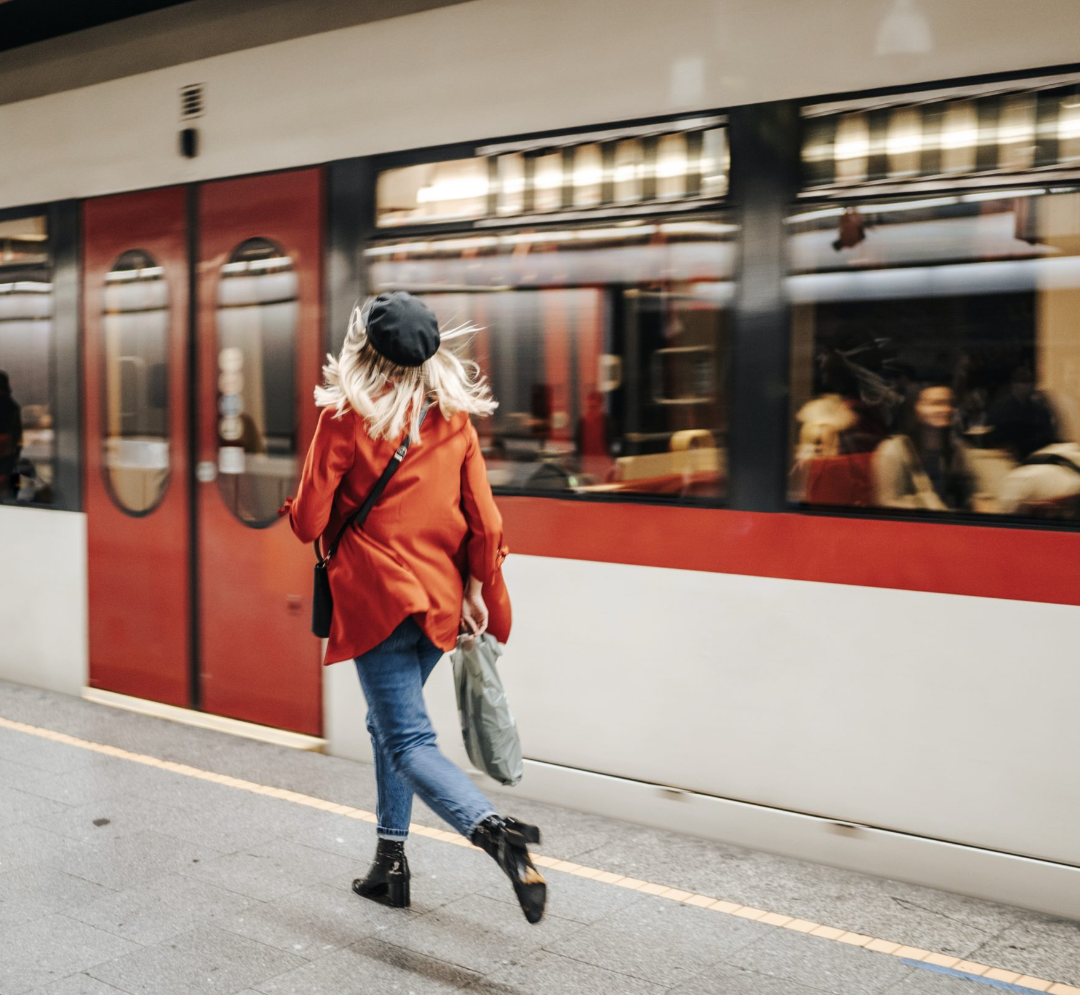
Introduction Carteira Virtual Urbanos do Porto
Contextualization
Why this project?
Interests

Slide 3
Objectives Carteira Virtual Urbanos do Porto
Benefits
Save time in queues and on old machines
Increases accessibility
Take up less space with cards
Reduce resource consumption
Goals
Replace physical cards with a virtual wallet
Buy travel anywhere on your mobile phone
Check the available schedule for each route

Slide 4
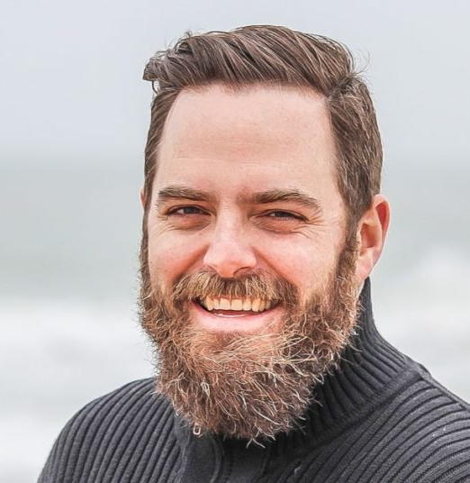
Persona Carteira Virtual Urbanos do Porto
Name: Peter Griffin
Gender: Male
Age: 45
Profession: University professor
Background: Married and father of three, they live in Ovar
Main motivations: Likes to travel, takes the kids to school every day
Goals and needs: Fulfill family duties, enjoy traveling hassle free

Slide 5
Scenarios Carteira Virtual Urbanos do Porto
Peter is tired of carrying his wallet full of cards
He discovers the new virtual wallet for Porto's urban trains
Peter registers his usual card in the wallet associated with his new profile
Peter arrives at the station with his family to catch the next train
He sees in the app when the next train to their destination is
The train arrives on time and Peter validates the tickets for the whole family with the NFC of his cell phone one by one
Peter decides to take the family out for the weekend
He needs to buy a new card for his wife and one trip
He buys a new card automatically associated with his profile through the application
He buys a new trip for her

Slide 6
Tasks Carteira Virtual Urbanos do Porto
0 - Buying a ticket
1 - Open App
2 - Open the Cards Menu
3 - Add card
5 - Time Menu
4 - Confirm payment
6 - Enter origin and destination Stations
7 - Confirm Payment

Slide 7
Tasks Carteira Virtual Urbanos do Porto
0 - Register a card
1 - Open App
2 - Open the Cards Menu
3 - Register a card
4 - Insert card reference
5 - Confirm Registration

Slide 8
Tasks Carteira Virtual Urbanos do Porto
0 – Check Timetable
1 - Open App
2 - Open Timetable
3 - Enter origin and destination Stations
5 - Confirm Selection

Slide 9
Tasks Carteira Virtual Urbanos do Porto
0 - Validate the ticket
1 - Open App
2 - Open the Cards Menu
3 – Select card
4 – Choose validate
5 – Put mobile phone to machine

Slide 10
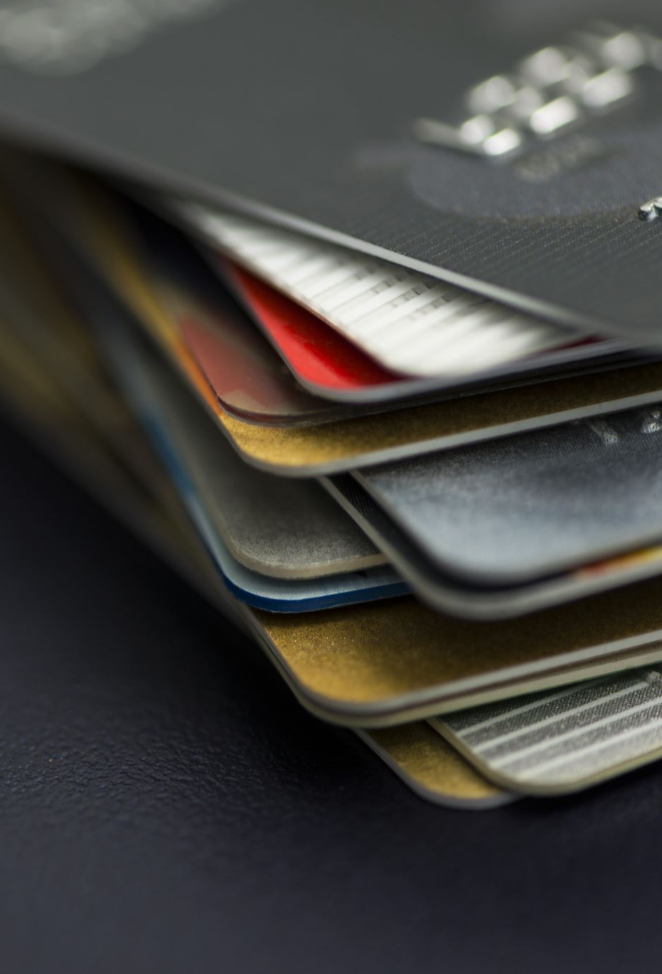
Functional Requirements Carteira Virtual Urbanos do Porto
Have multiple cards with each card holding only one trip
Create multiple cards
Register an existing physical card
Buy tickets through digital payment methods
Validate tickets by nfc

Slide 11
Non-functional Requirements Carteira Virtual Urbanos do Porto
Available anytime
Easy to learn and use
Store data
Data security

Slide 12
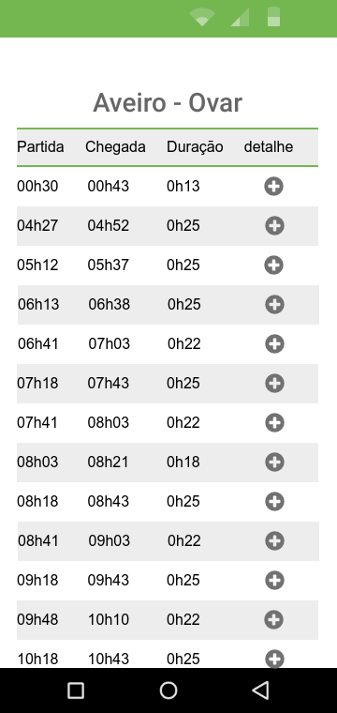
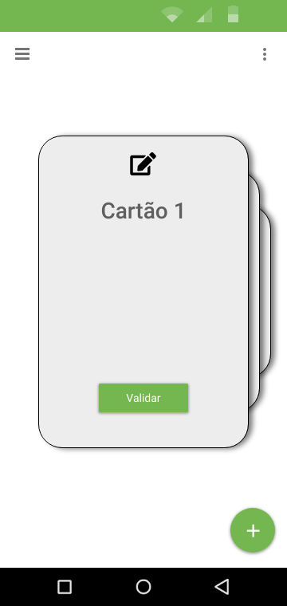
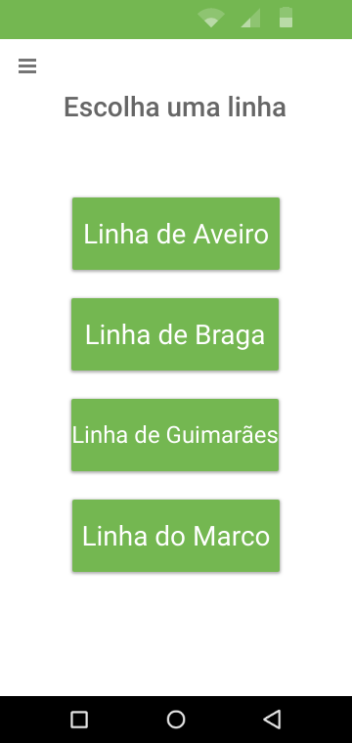
Low Fidelity Prototype (LFP) Carteira Virtual Urbanos do Porto
The prototype was made using the Proto.io program and its main features were:
Validate cards
See schedules
Make payments

Slide 13

LFP User Evaluation Carteira Virtual Urbanos do Porto
With this prototype we tried to find the main usability problems and inconsistencies and see if the tasks made sense
The following tasks were all assigned to IHC students aged 19 to 25:
Trying to buy and register a new card
Attempt to validate a card
Try to search for a time for a specific route
Trying to buy a ride for a specific route

Slide 14
LFP User Evaluation Carteira Virtual Urbanos do Porto
Some of the main comments on LFP usability:
“The cards tab is not clear”
“The detail icon is not intuitive”
“The timetable and purchase menu must be linked”
“Lines menu is not easy to use”
Notes:
Cartões -> Cartões de Viagem
Tecla para cancelar
add Métodos de Pagamento
Mudar ícon "detalhes“
Origem e Destino negrito caps lock
Add setas voltar atrás Menu de escolher linhas é pouco intuitivo
Conciliar menu de horários com menu de pagamentos
Separar "+" em dois botões

Slide 15


Platform Used for the functional prototype Carteira Virtual Urbanos do Porto
The tools used were:
React Native (development language)
Expo Snack (IDE, code sharing and emulator)

Slide 16
High Fidelity Prototype (HFP) Carteira Virtual Urbanos do Porto
The tasks we tested for this prototype were:
Try renaming one of your cards
Point out the Porto-Campanhã station on the map
Buy an Aveiro-Espinho trip and how much it cost
Try to validate one of your cards
Try to register a new card in the wallet using the code on the physical card
Try buying a new card and how much it cost
Check the available times to make the Aveiro-Ovar trip.

Slide 17
High Fidelity Prototype (HFP) Carteira Virtual Urbanos do Porto
The following features have been added:
Scrollable card menu
Map
Schedules and purchase tabs were merged
Buy menu works by search only
Changed button design and layout for more intuitiveness
Other aesthetic issues

Slide 18
High Fidelity Prototype (HFP) Carteira Virtual Urbanos do Porto
The sample used is 8 IHC students between 19 and 25 years old.
The questionnaires provided on the e-learning page of the course were used and the results for tasks were as follows:

Slide 19
High Fidelity Prototype (HFP) Carteira Virtual Urbanos do Porto
Feedback from users:
“Should have a help button”
“It makes no sense to have different cards, a payment confirmation request will be useful, the menu to buy trips and where to buy the card are confused”
“Should have a different color, task 2 is unclear”
After user feedback, the following changes were made:
Main color changed
Added a payment confirmation interface
Added captions to buttons to improve intuitiveness

Slide 20
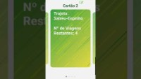
DEMO Carteira Virtual Urbanos do Porto

Slide 21

Future Work
Complete the databases of all service lines
Store the databases in a suitable format
Make timetables available in downloadable pdfs
Implement 100% functional means of payment
Create a tutorial of the app when it is first opened
Place the validate button in a more appealing place on the screen
Allow greater customization of cards
Add autocomplete in time search
Implement user statistics

Slide 22
Effort of each group member
Gonçalo Abrantes – 40%
Guilherme Antunes – 60%

Slide 23

Acknowledgments
Special thanks to:
• Participants who contributed to gave us a valid feedback of the application.
• IHC teachers for helping us and also giving some suggestions.

Slide 24
Thank You

